Slide 1
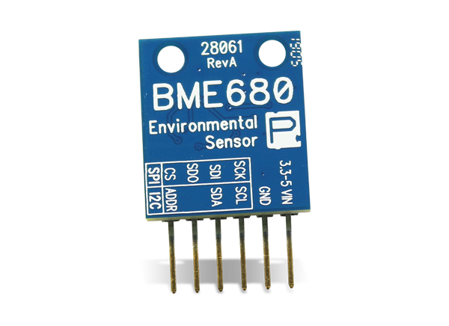
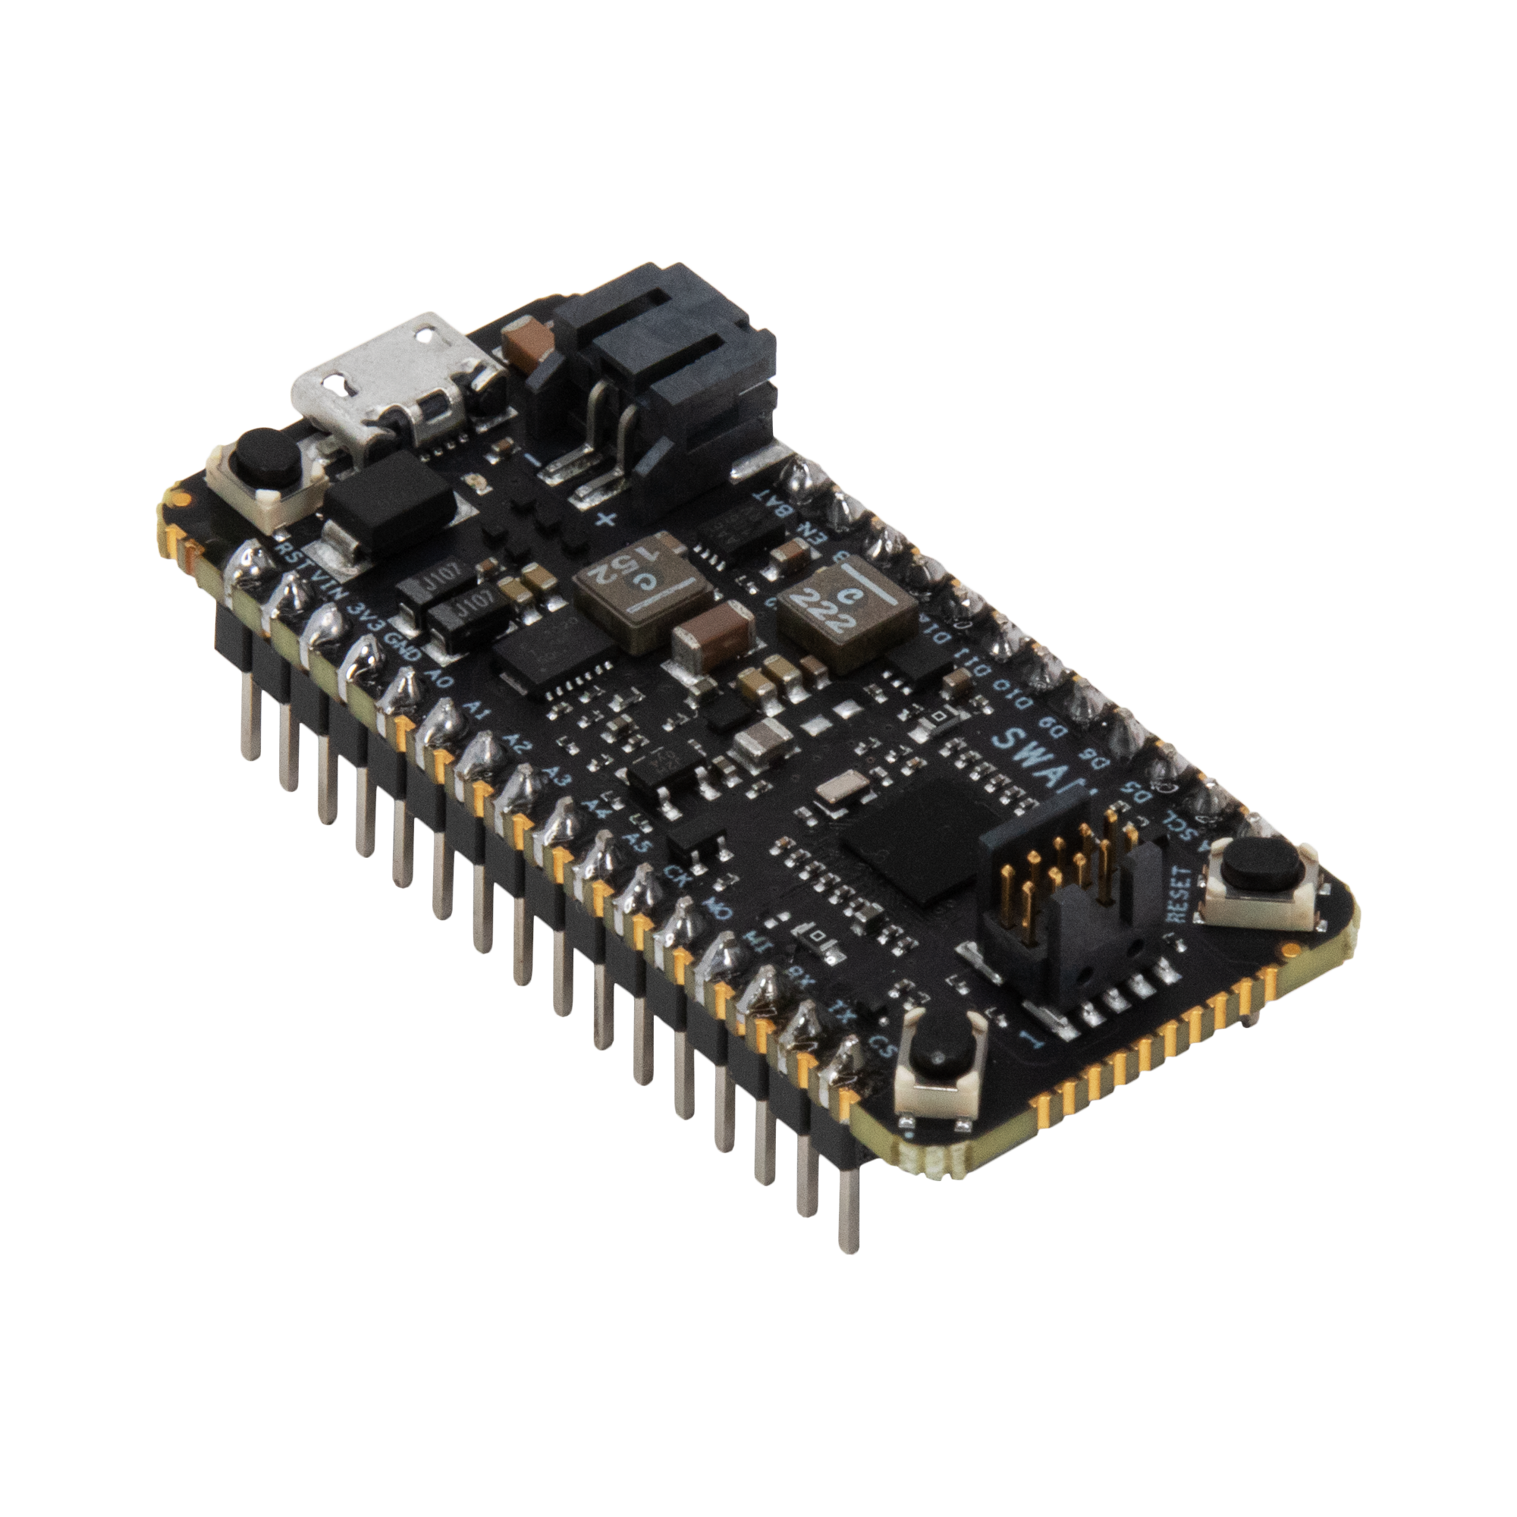
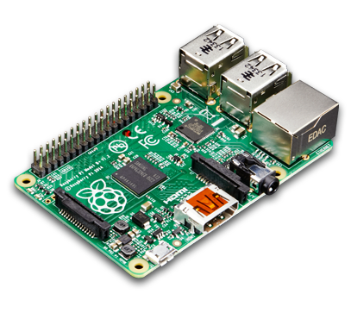
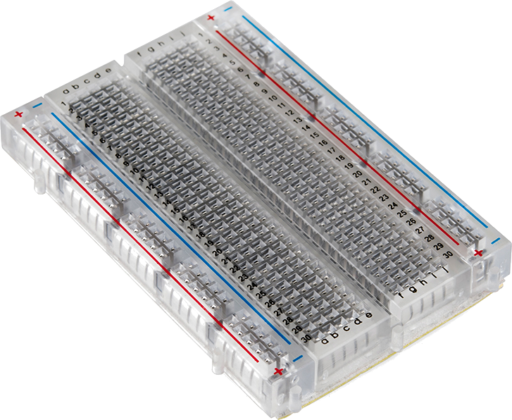
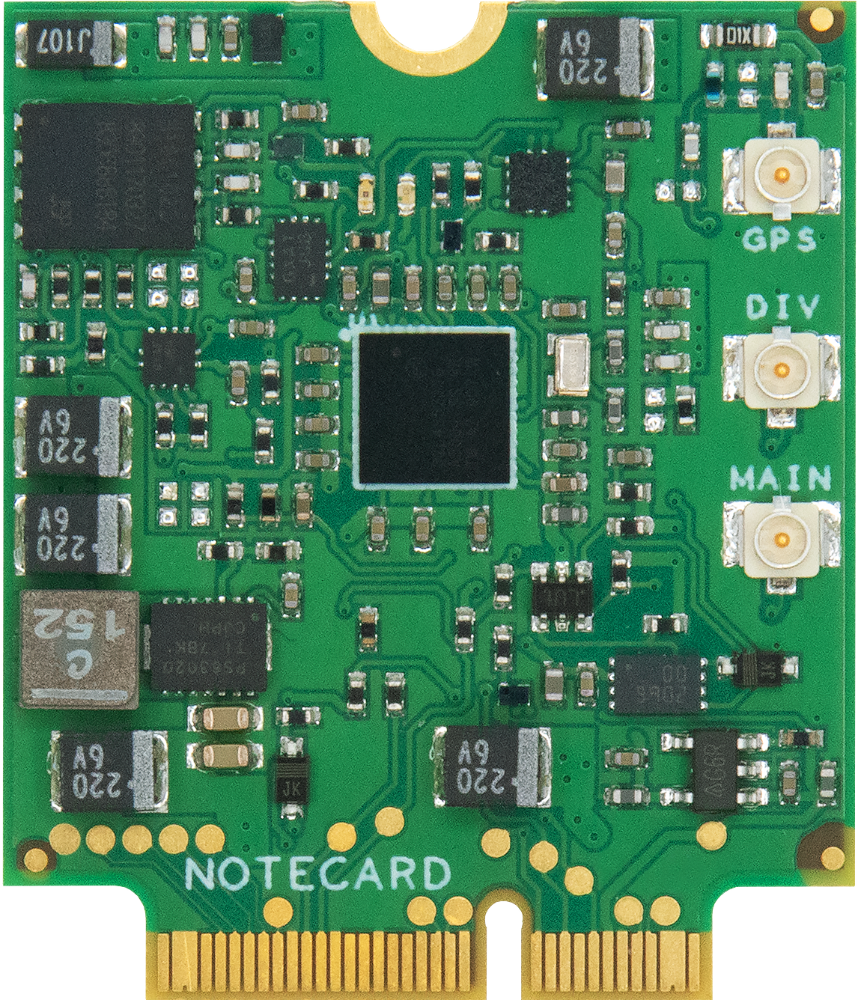

IoT 101 (a.k.a. The IoT is Dead)
Rob Lauer
Director of Developer Relations

Slide 2
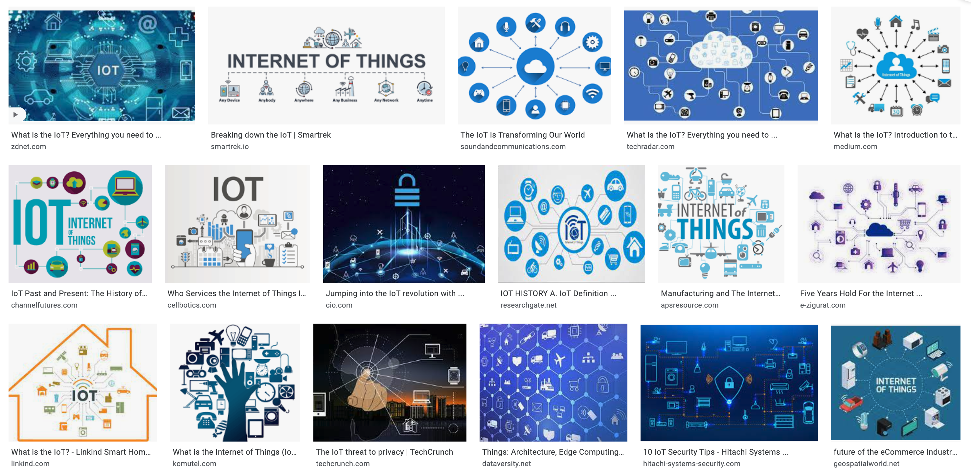

Slide 3
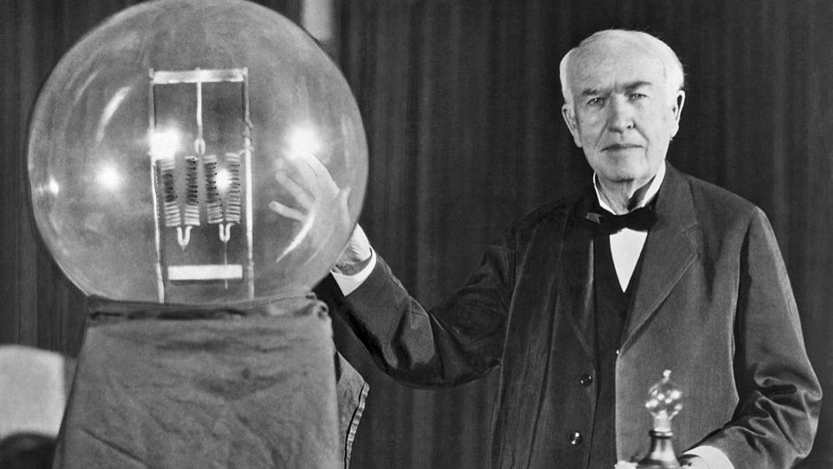

Slide 5
When wireless is perfectly applied the whole earth will be converted into a huge brain, which in fact it is, all things being particles of a real and rhythmic whole…and the instruments through which we shall be able to do this will be amazingly simple compared with our present telephone. A man will be able to carry one in his vest pocket.
Nikola Tesla

Slide 6
PC
Internet
Mobile
Mainframe
Size
Quantity

Slide 8
75 BILLION
Devices online by 2025
$15 TRILLION
Spent on the IoT (2019-2025)

Slide 9
Promise vs. Messy Reality
The IoT

Slide 10
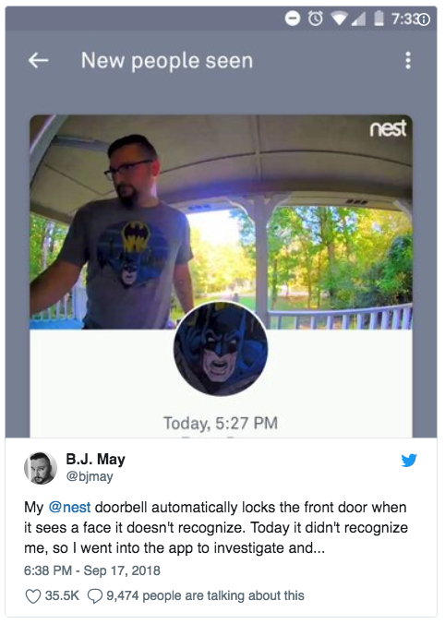
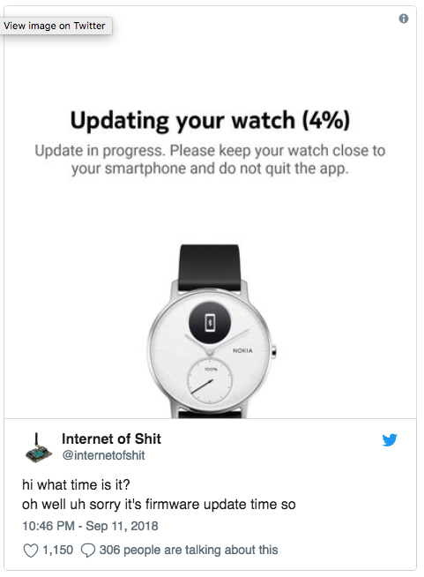
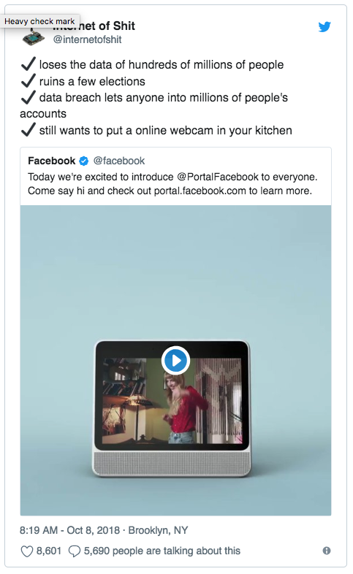
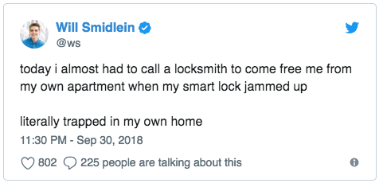
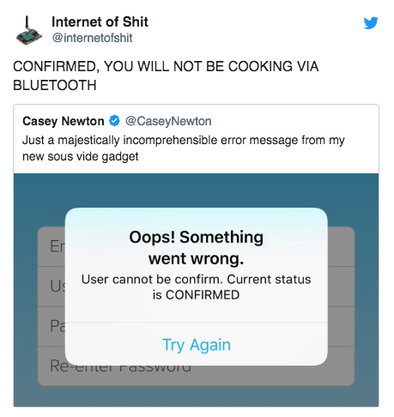
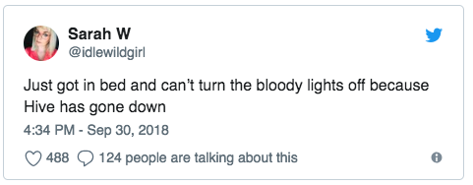
Expectations vs Reality

Slide 11
visibility
Peak of inflated expectations
Plateau of productivity
Slope of enlightenment
IoT TODAY 😔
Trough of disillusionment
INNOVATION trigger
Time

Slide 12


Slide 13
An Informal History of Laughable Innovations 🤣

Slide 14
The Television
“
Radio is the theater of the mind; television is the theater of the mindless.
- Steve Allen
”

Slide 15
The Television
“
Television won't be able to hold on to any market it captures after the first six months. People will soon get tired of staring at a plywood box every night.
- Darryl Zanuck
”

Slide 16
The Personal Computer
“
There is no reason anyone would want a computer in their home.
- Ken Olsen
”

Slide 17
The Personal Computer
“
I think there is a world market for maybe five computers.
- Thomas Watson
”

Slide 18
The Internet
“
I predict the Internet will soon go spectacularly supernova and in 1996 catastrophically collapse.
- Robert Metcalfe
📈
”

Slide 19
Mobility
“
“
There’s no chance that the iPhone is going to get any significant market share.
- Steve Ballmer
The iPad is ridiculous. It’s just a big iPhone.
- Rob Lauer
”
”
$3 TRILLION
Apple’s Market Cap

Slide 20


Slide 21
Every Innovation Follows a Pattern
visibility
Peak of inflated expectations
🤔
😍
Plateau of productivity
😕
😅
🤩
Slope of enlightenment
🤬
Trough of disillusionment
INNOVATION trigger
Time

Slide 22
Every Innovation Follows a Pattern
visibility
Peak of inflated expectations
🤔
THIS IS WHEre THE REAL WORK HAPPENS!
😍
Plateau of productivity
😕
😅
🤩
Slope of enlightenment
🤬
Trough of disillusionment
INNOVATION trigger
Time

Slide 23
Long Live the Internet 👑

Slide 24
The Internet of…?
The Internet of Personal Computers?
The Internet of Mobility?
The Internet of Things?

Slide 25
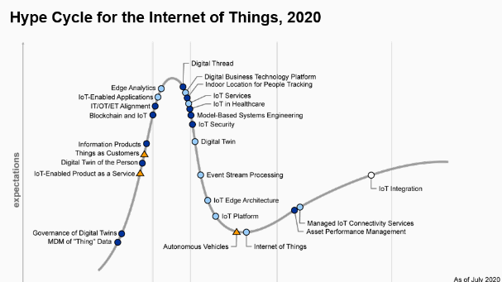

Slide 26
IoT: It’s Just the Internet 📶

Slide 27
visibility
Peak of inflated expectations
Plateau of productivity
IoT TOMORROW! 😍
Slope of enlightenment
IoT TODAY 😔
Trough of disillusionment
INNOVATION trigger
Time

Slide 28
How Do We Exit the Trough?
1
2
3
Focus on Solving Real Problems
Be Smarter about Connectivity and Security
Embrace the Internet

Slide 29
Solving Real Problems 🛠

Slide 30
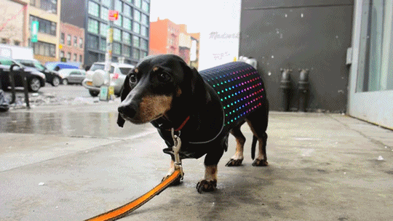
So preoccupied with whether they could, didn’t stop to think if they should!

Slide 33
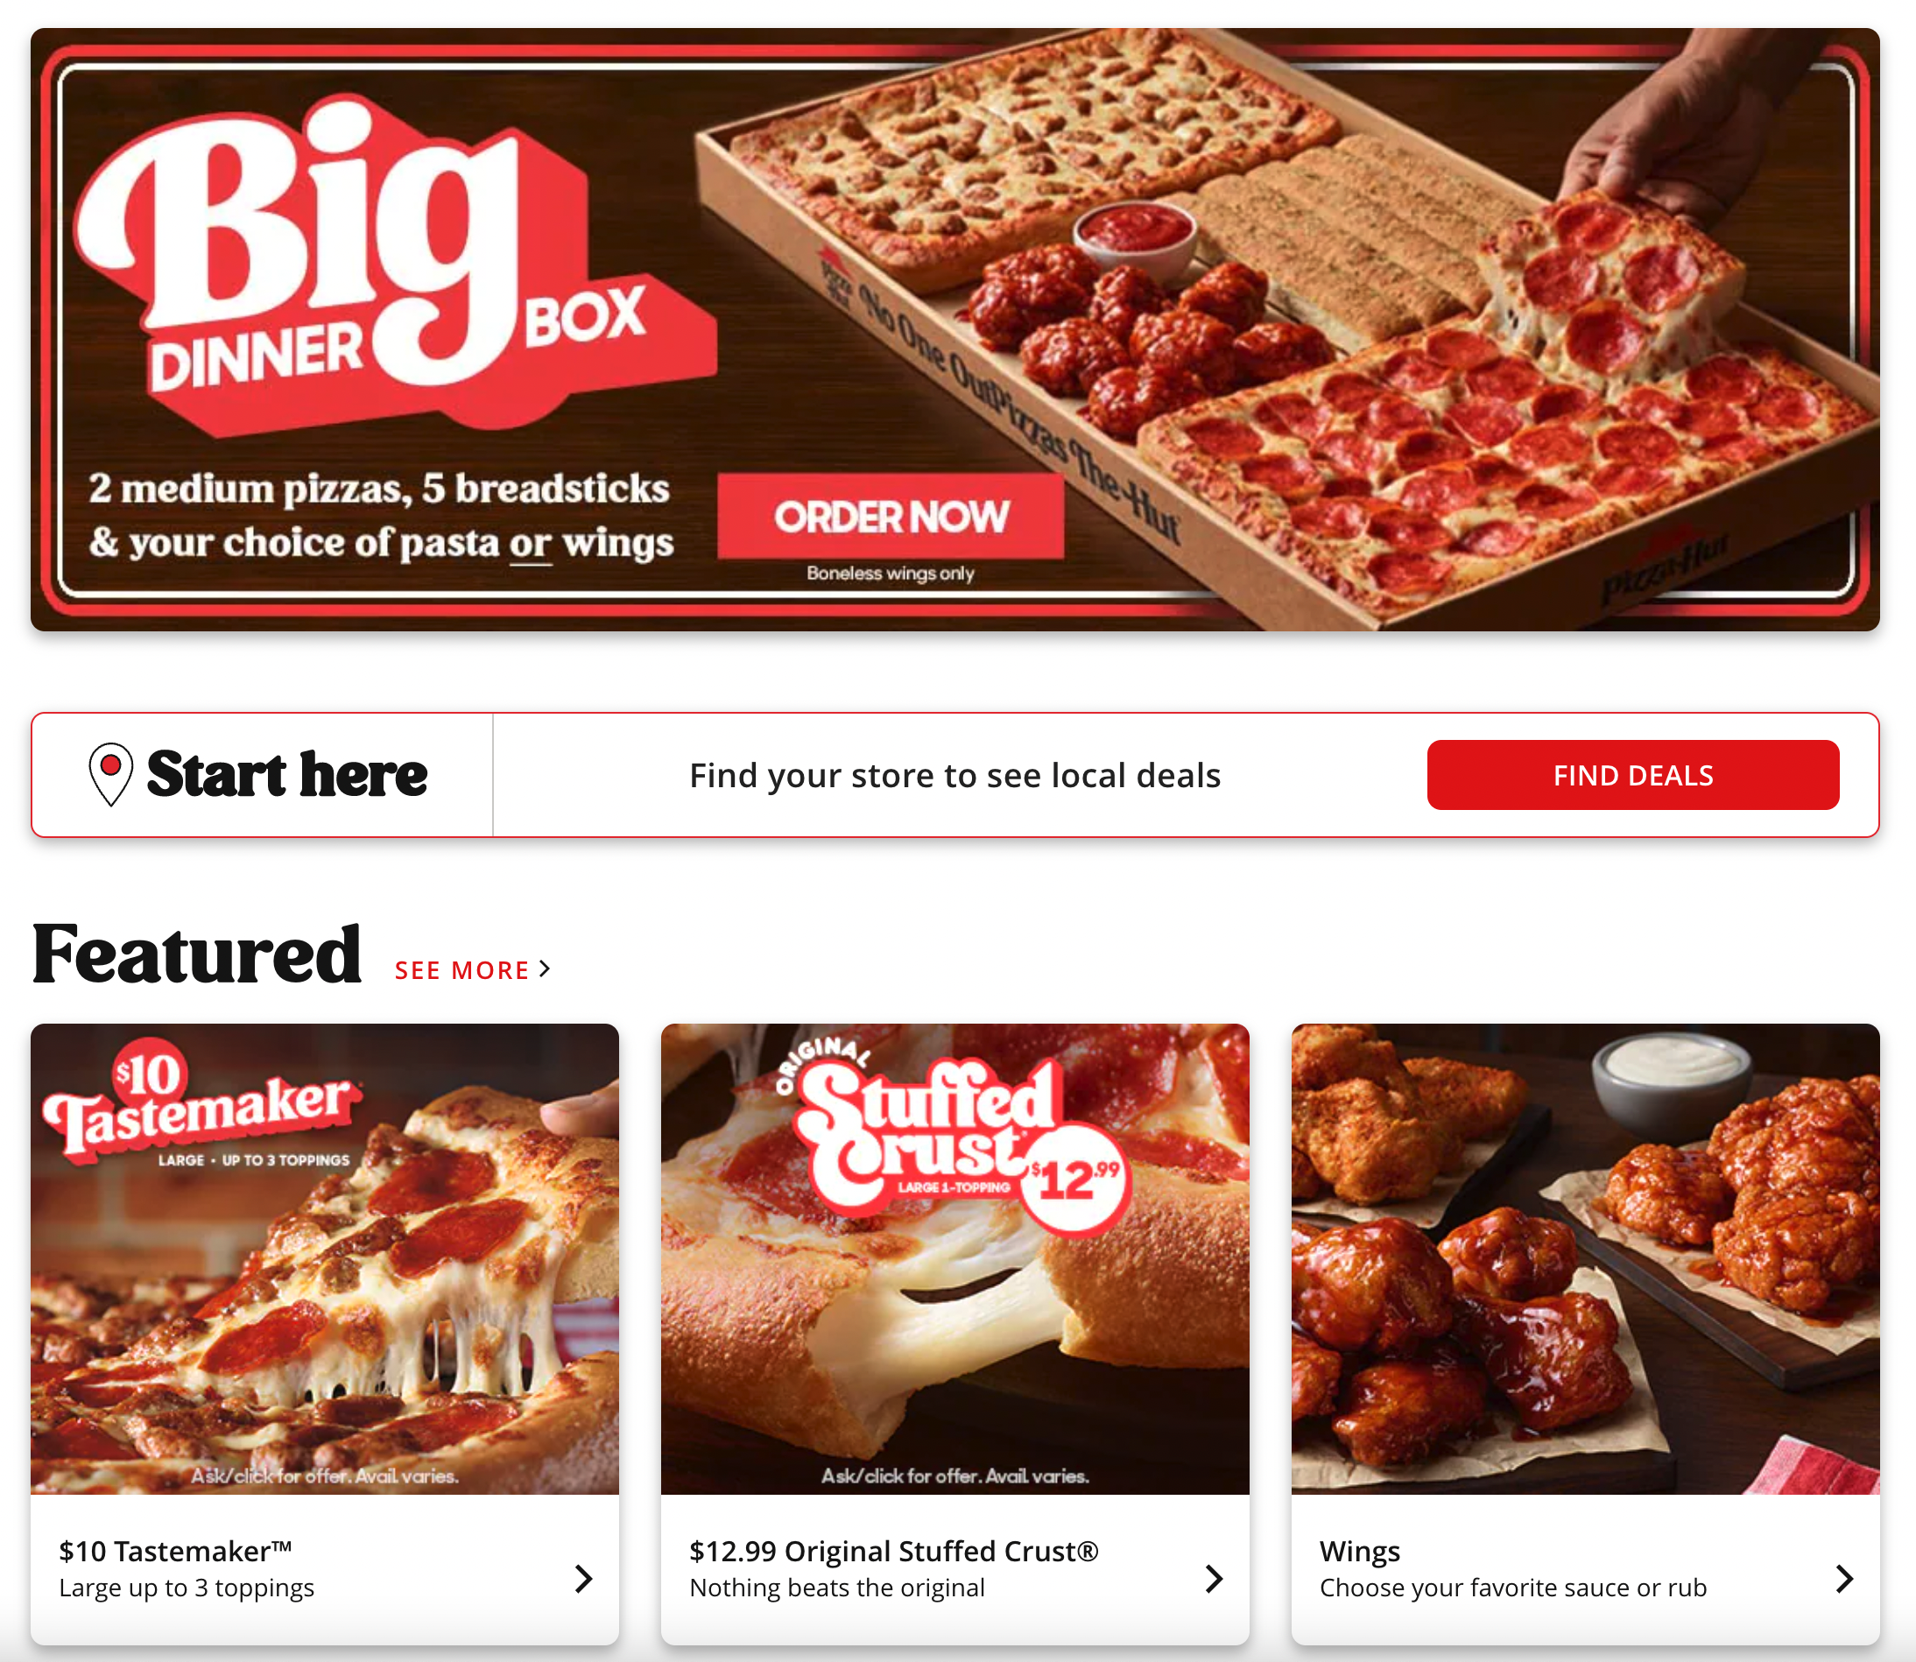

Slide 34
With the Internet, Connectivity Enabled
Commerce 💰

Slide 35
With the IoT, Connectivity Enables Control ⚡️

Slide 36


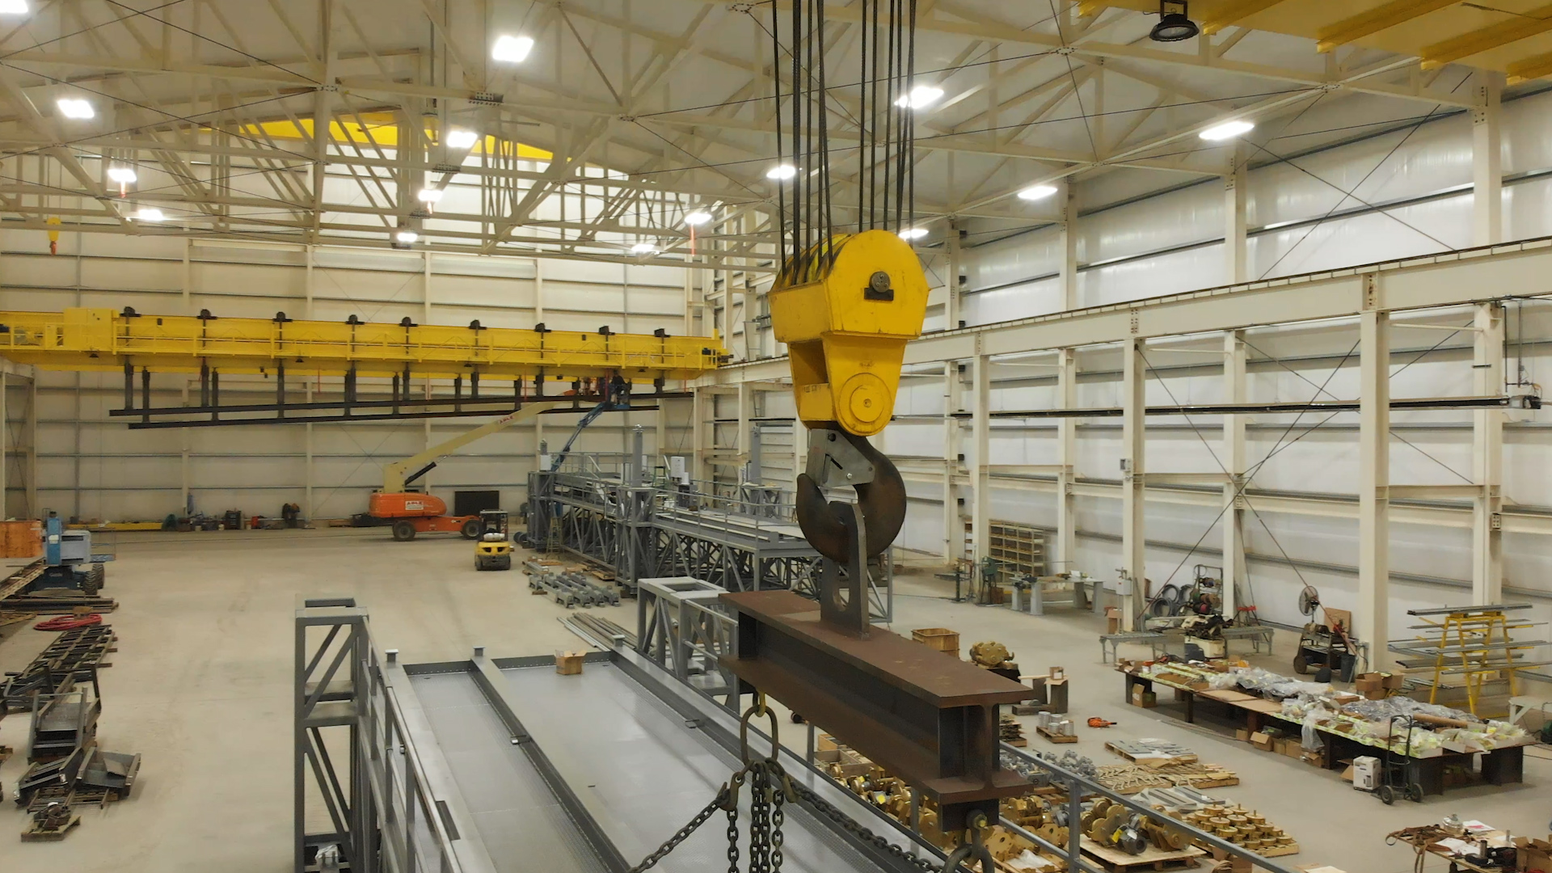
“American Crane & Equipment Corporation has unlocked 10x lower up-front costs vs. out-of-the-box solutions.”

Slide 37


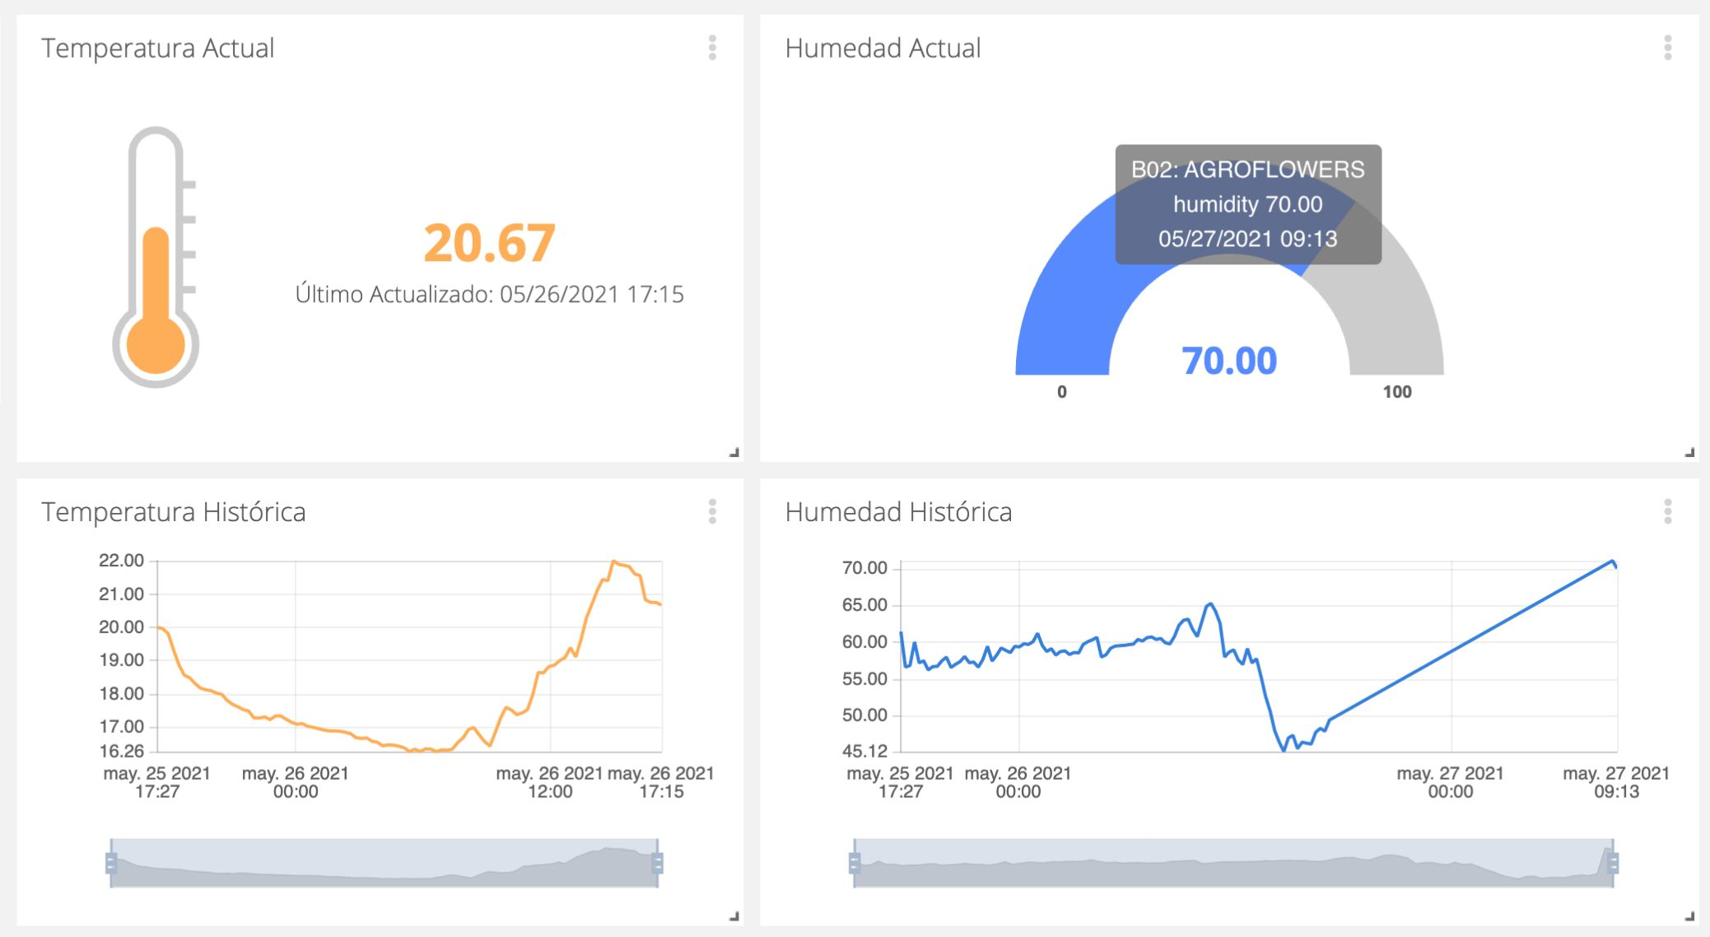
“Instead of the farm having to send somebody out to every greenhouse to read the current temperature and humidity of each greenhouse, for very little money you can have data points every 10 or 15 minutes.”

Slide 38
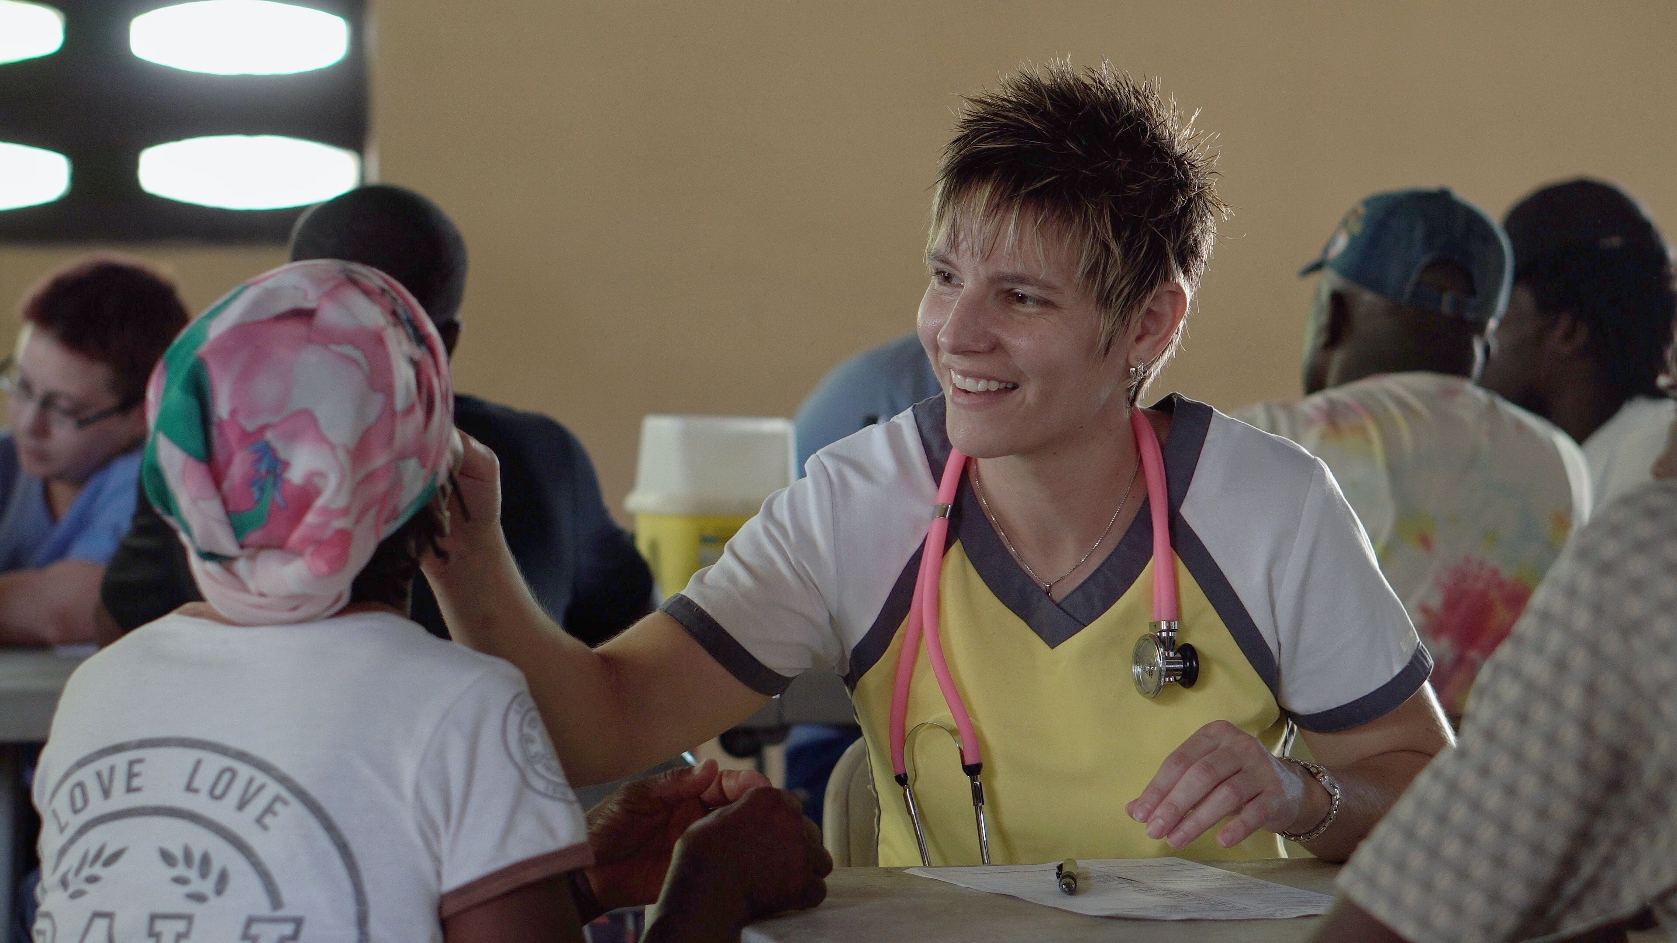
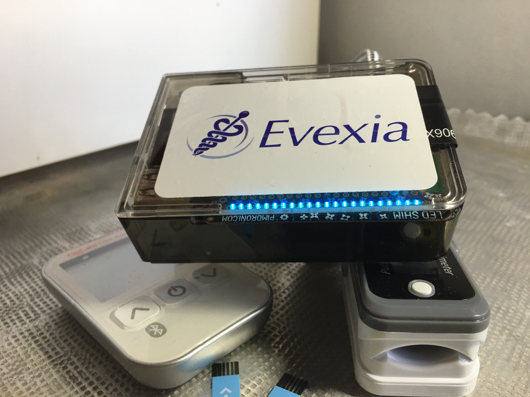
“By offloading the complexity of moving sensor data over cellular networks, we get to market faster and there less that can go wrong.”

Slide 39
Solving Problems where Connectivity is the
Secret Sauce 👩‍🍳

Slide 40
Smarter Connectivity and Security 🔒

Slide 41
LoRa
Wi-Fi is Brittle
Cellular is Expensive
Bluetooth is Limited
LoRaWAN is Constrained

Slide 42
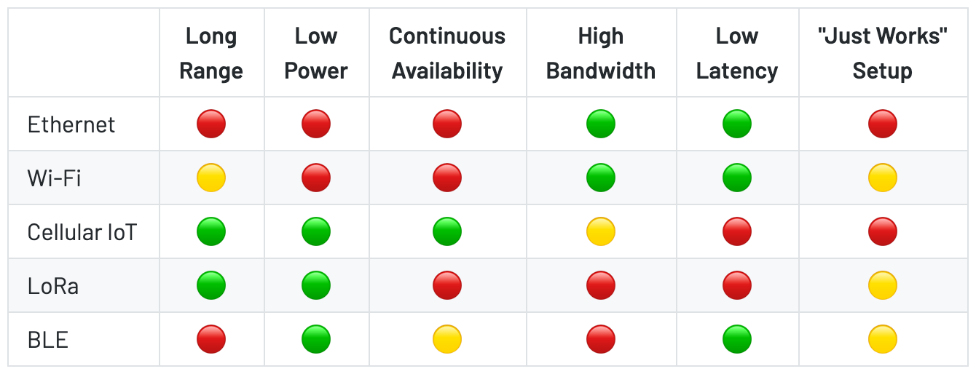

Slide 43
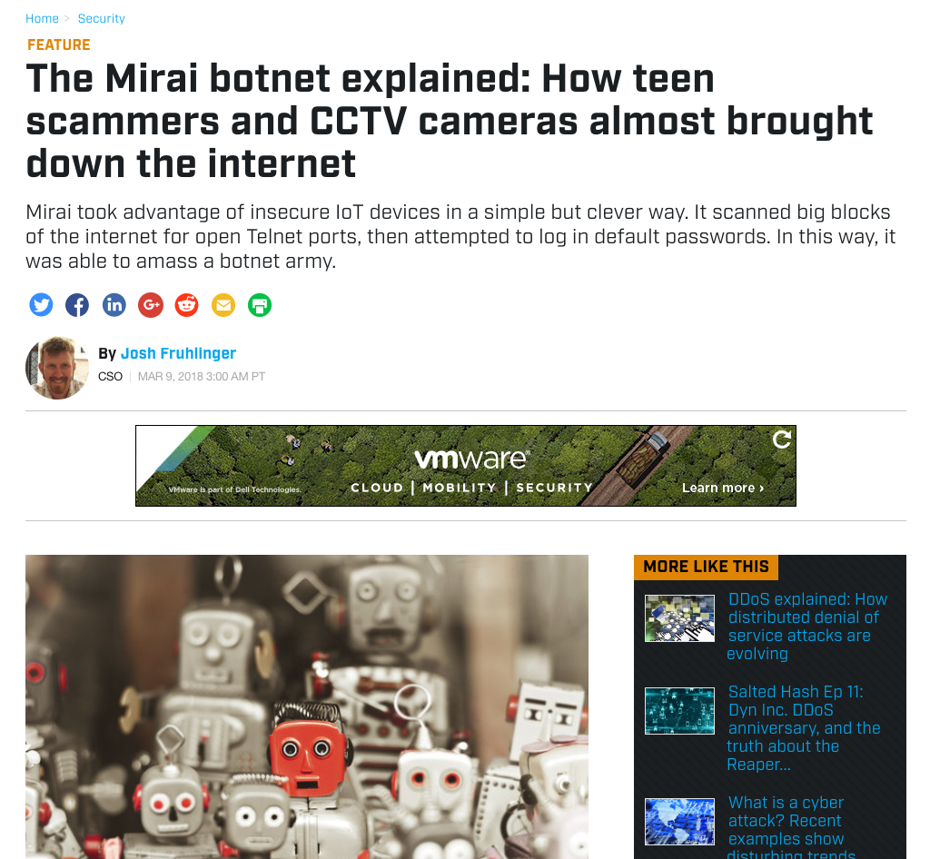
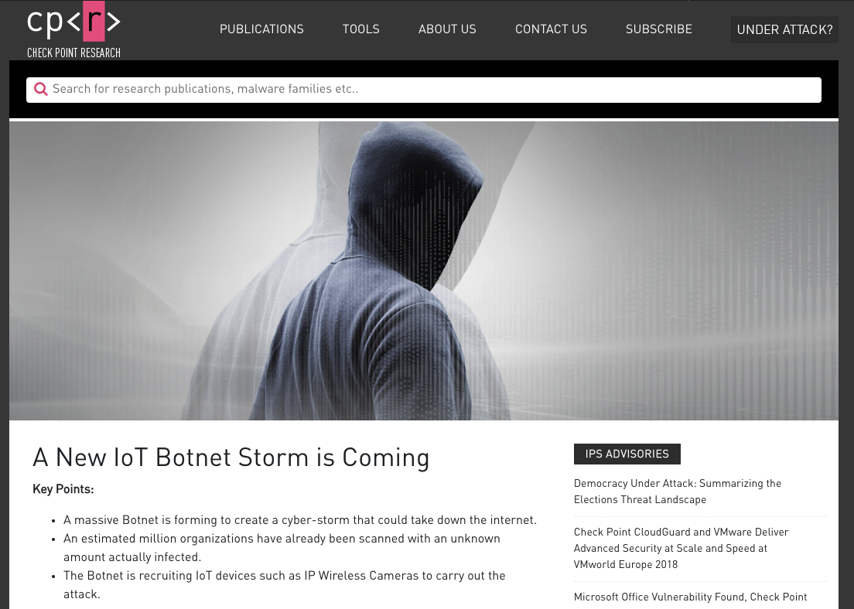
Is Internet-Connected the Right Choice?

Slide 44
The IoT Needs Less Internet 📵

Slide 45
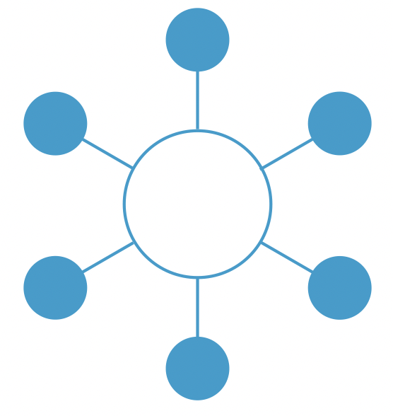
LoRaWAN

Slide 46
Embracing the Internet 🤗

Slide 47

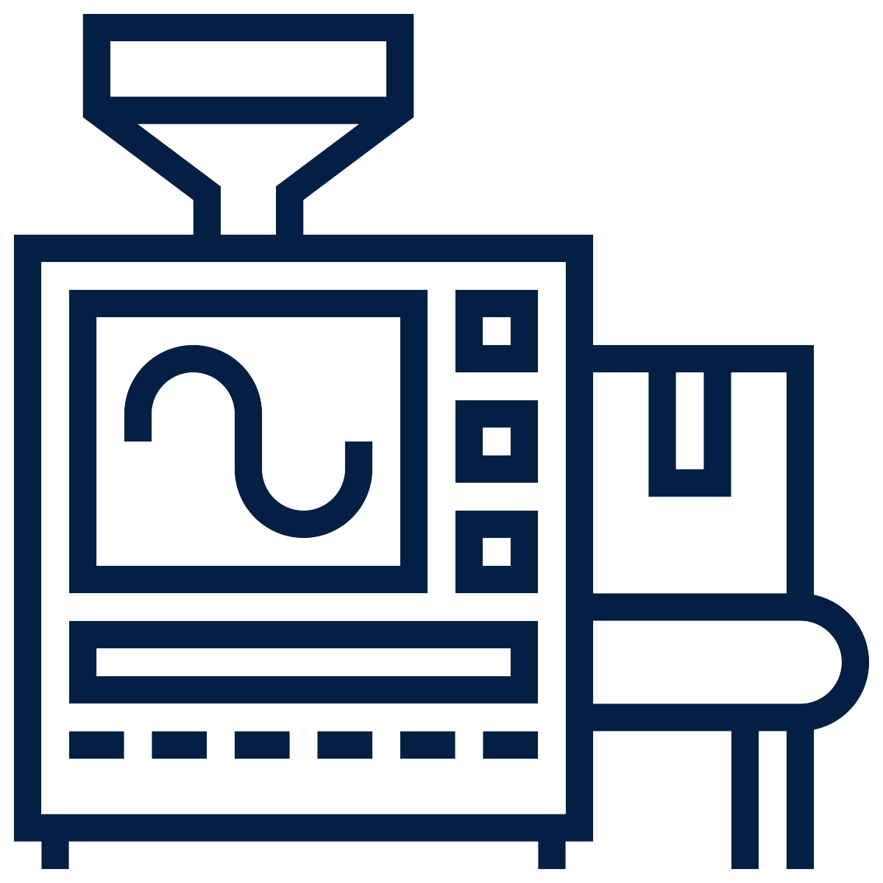


From Closed to Open

Slide 48





From Closed to Open

Slide 49
“The IoT” is a Foreign World
👆 What a typical hardware engineer understands today

Slide 50


Slide 51














Languages
Platforms
Capabilities

Slide 52
The IoT is Dead! Long Live the IoT! 👑

